Slide 1

DriverPass
System Analysis
[Jonathan Brennan]
Notes:
[No speaker notes required for this slide.]

Slide 2

System Requirements
Real-Time Booking: Students book lessons instantly from any device.
Instant Grading: Practice tests grade themselves and log progress automatically.
Fast Loading: Pages load in under 2 seconds.
Account Safety: Accounts lock after 5 failed login attempts to protect data.
Notes:
[This slide highlights how our system supports DriverPass. For students, the calendar handles bookings automatically, while self-paced practice tests grade themselves to help them pass their exams. Under the hood, pages load in under two seconds and accounts lock after repeated failed logins to keep data safe. It's built to be fast, reliable, and straightforward]

Slide 3
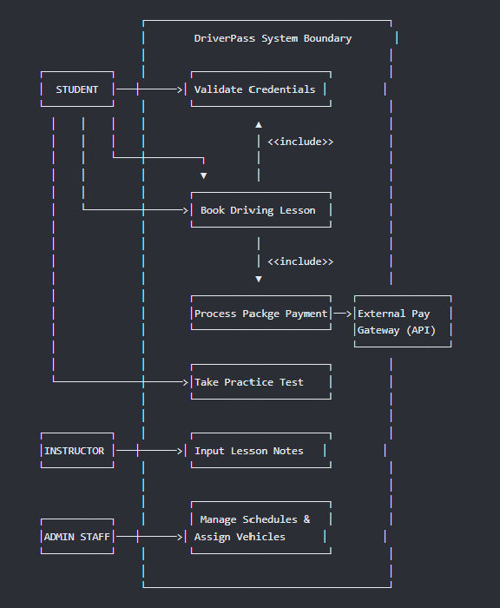
Use Case Diagram
User Roles: Mentions Students, Instructors, and Administrative Staff.
Core Interactions: Maps out account logging, scheduling lessons, and taking tests.
Payment Link: Automatically prompts payment processing during lesson booking.
Notes:
[This layout details exactly how different people interact with the software. We map out roles for your students, instructors, and office staff. It shows how students book lessons, take tests, and process payments seamlessly, while instructors add notes and staff manage the schedules. This organizes your entire operation into a single, straightforward system.]

Slide 4
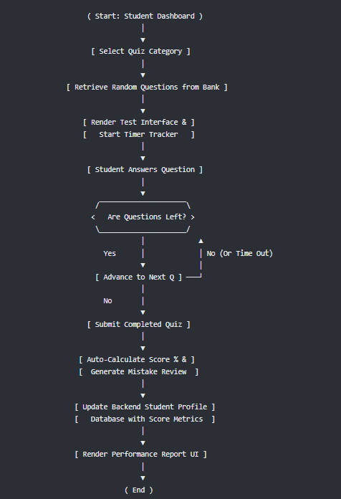
Activity
Diagram
Notes:
[This flow chart details how a student books a driving lesson step-by-step. The system displays open times, checks availability instantly to prevent double-booking, and safely confirms payment. If a slot is taken or payment fails, it guides the student smoothly back to try another time. This keeps booking fast and error-free for your clients.]

Slide 5
Security
Data Encryption: Scrambles student login passwords and card information so they cannot be stolen.
Hacking Prevention: Temporarily blocks access for 15 minutes after 5 bad login attempts.
Safe Password Recovery: Emails a secure, timed reset link if a user forgets their password.
Secure Connections: Uses protected web networks to safeguard all traffic between students and servers.
Notes:
[Security is a top priority for protecting your students and your business data. This design protects passwords and personal details by scrambling them so hackers cannot read them. We have also added an automatic lock feature to block anyone attempting to repeatedly guess a password. If a user genuine forgets theirs, they receive a secure, time-limited reset email. This keeps your system safe without complicating things for your customers.]

Slide 6
System Limitations
No Offline Mode: Users must have an active internet connection to book lessons or take tests.
No Fleet Tracking: The system does not track car fuel levels, maintenance, or vehicle GPS locations.
No Tax Accounting: Corporate tax filings and employee payroll processing are outside the system's scope.
Third-Party Dependency: relies entirely on external banking networks to process financial transactions.
Notes:
[To keep expectations clear, we want to highlight what the system does not do. This application focuses strictly on scheduling lessons and managing online practice tests. It does not handle vehicle maintenance, track car fuel, or process your company's tax documents. Additionally, because it operates entirely online, users need an active internet connection to interact with it, and payments rely on outside banking systems. Keeping the scope focused this way ensures the core tool remains incredibly reliable and fast.]

